Slide 1
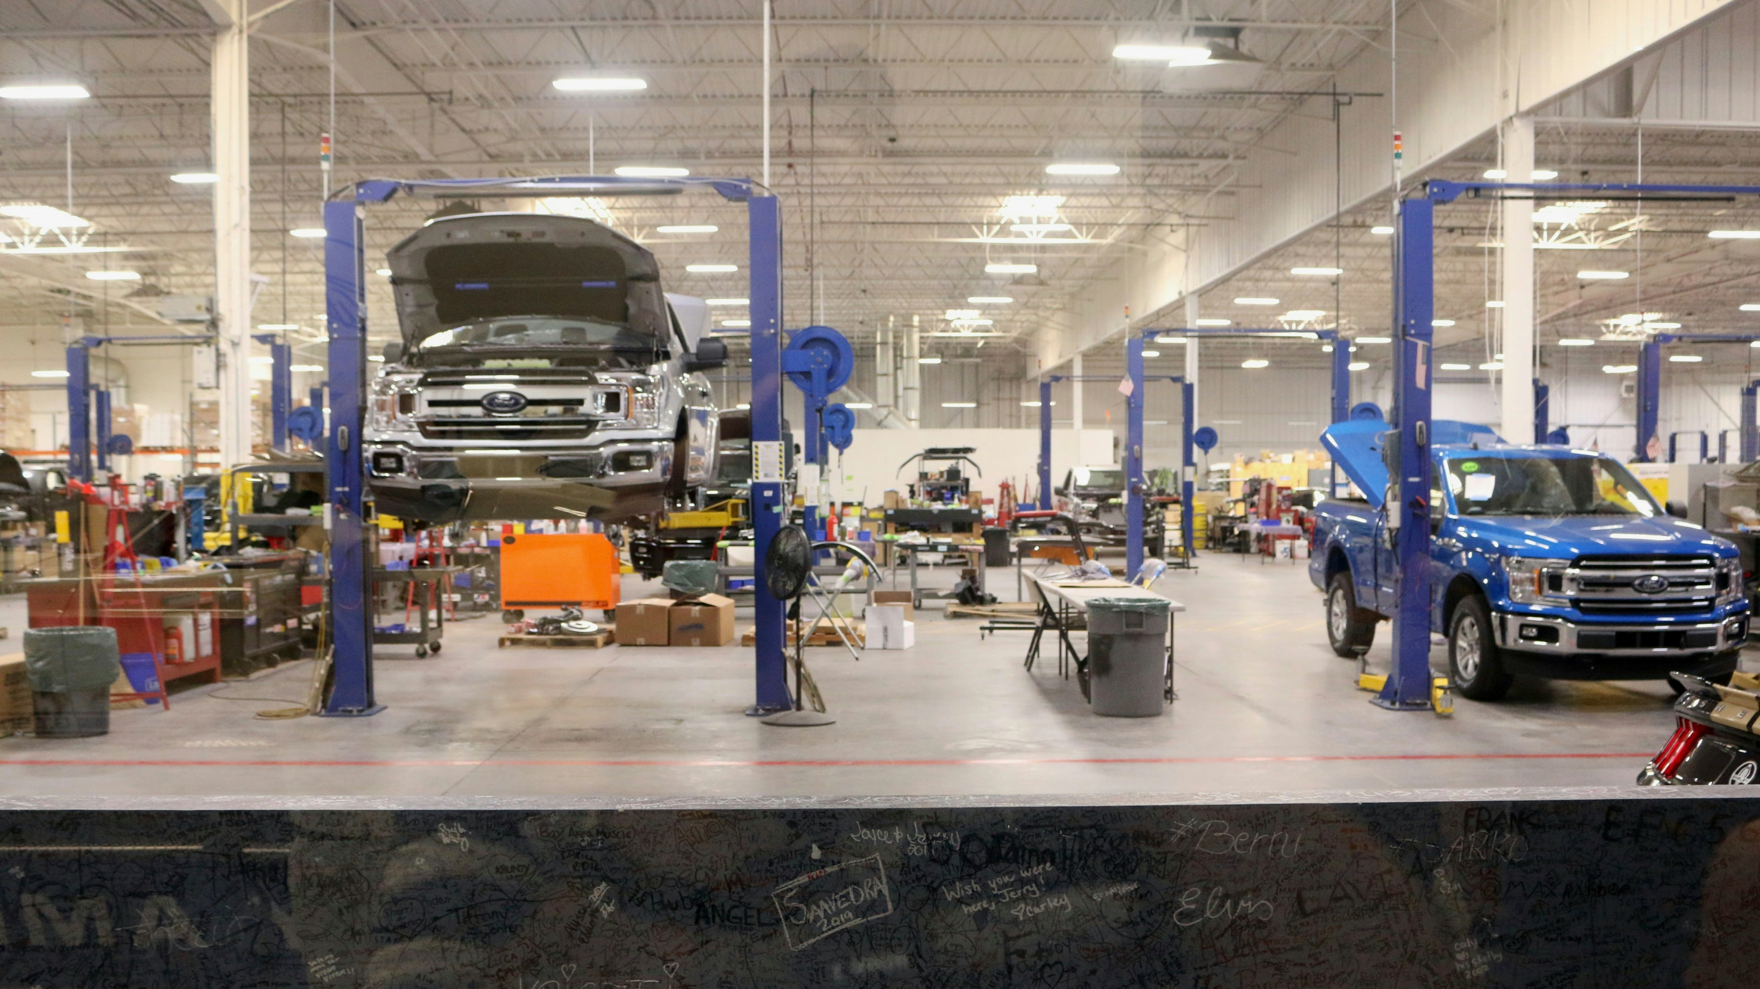
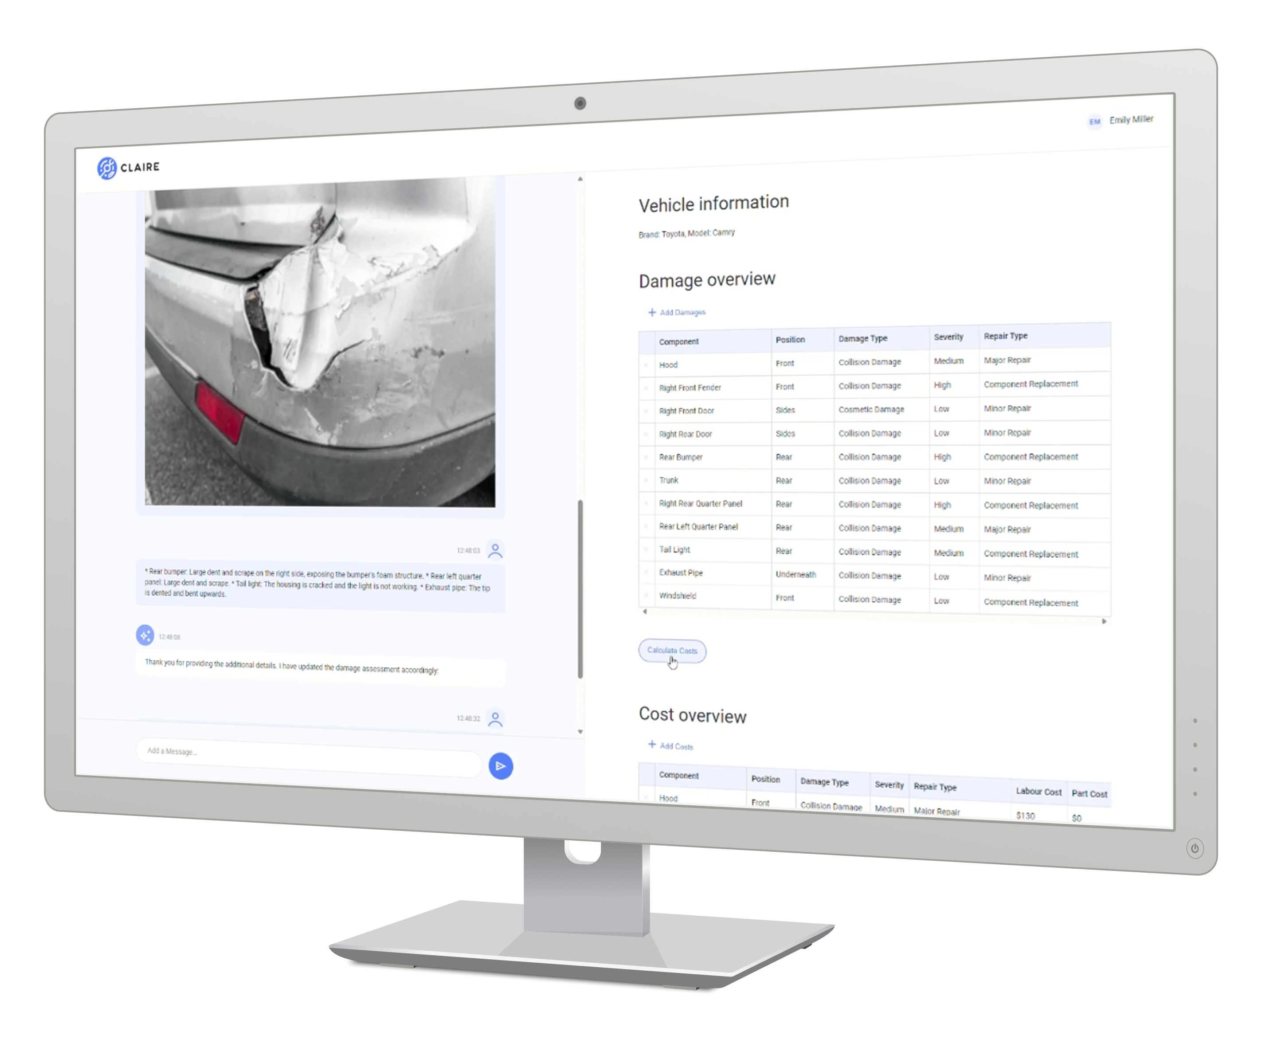



AI Service for Car Workshops
Automobile (A-4)
Streamlining the damage and cost estimation process for repairing damaged vehicles by leveraging multi-modal generative AI capabilities with
Team AI GENies | March 24, 2024
Google Gloud GenAI Hackathon 2024
X
X
Notes:
Cover image should provide an iconic representation of the project; a signature photo or hero mock-up. “How would we show the project in a magazine?”

Slide 2








We Examined the Challenges Confronting the Car Repair Estimation Process
Problem Statement
High Demand:
6 million car accidents occur annually on average in the U.S.
Trust Gap:
30% of customers reported a lack of trust towards repair shops in the U.S.
Bureaucratic Hurdles:
3 different repair estimates are typically claimed by Insurance.
High Demand:
6 million car accidents occur annually on average in the U.S.¹
Trust Gap:
30% of customers reported a lack of trust towards repair shops in the U.S.²
Bureaucratic Hurdles:
3 different repair estimates are typically claimed by Insurance.³
Pain points of a typical repair estimation process
Initial Inspection
Detailed Evaluation
Cost Estimate Preparation
Insurance Communication
Pain points of a typical repair estimation process
Initial Inspection
Detailed Evaluation
Cost Estimate Preparation
Insurance Integration
Time Constraints: High volume delays.
Oversight Risk: Potential missed damages.
Physical Dependency: In-person inspection needed.
Labor Intensive: Disassembly increases costs.
Hidden Damage Risk: Underestimation possible.
Dependency: Expertise and Advanced tools needed.
Error Prone: Manual calculations introduce mistakes.
Cost Variability: Inconsistent parts and labor rates.
Clarity Issues: Misunderstandings about costs/details.
Response Delays: Slow insurance feedback.
Dispute Potential: Risk of estimate contention.
Multiple Estimates: Extended approval times.
Expertise required: Damage assessment needs an experienced inspector.
Oversight Risk: Potentially oversaw damages.
Time Constraints: High volume delays.
Labor Intensive: Manual description of damages is a tedious routine.
Hidden Damage Risk: Underestimation possible.
Dependency: Expertise and advanced tools needed.
Error Prone: Manual calculations introduce mistakes.
Price Volatility: Ever changing parts cost and labor rates.
Clarity Issues: Misunderstandings about costs/details.
Response Delays: Slow insurance feedback.
Dispute Potential: Risk of estimate contention.
Multiple Estimates: Extended approval times.
Tackling these pain points in car estimation is crucial for refining the process, leading to improved efficiency, precision, and clarity in assessing both damages and costs.
Tackling these pain points in car estimation and automating key activities are crucial to improve time efficiency, damage and cost estimation quality, and create clarity between workshop, customer and insurance company.
¹ Overview Car Accident Statistics | ² Car Insurance Trust Blog | ³ Auto Repair Industry Statistics
Notes:
https://gitnux.org/u-s-auto-repair-industry-statistics/
When You Should Avoid Going Through Your Insurance for Car Repair | Valley Collision UT
https://www.ddlawtampa.com/resources/car-accident-statistics-you-need-to-know-in-2021/#:~:text=Total%20number%20of%20car%20accidents%20per%20year%20in%20the%20U.S.&text=This%20is%20up%20from%20238.6,losing%20their%20lives%20each%20year.

Slide 3
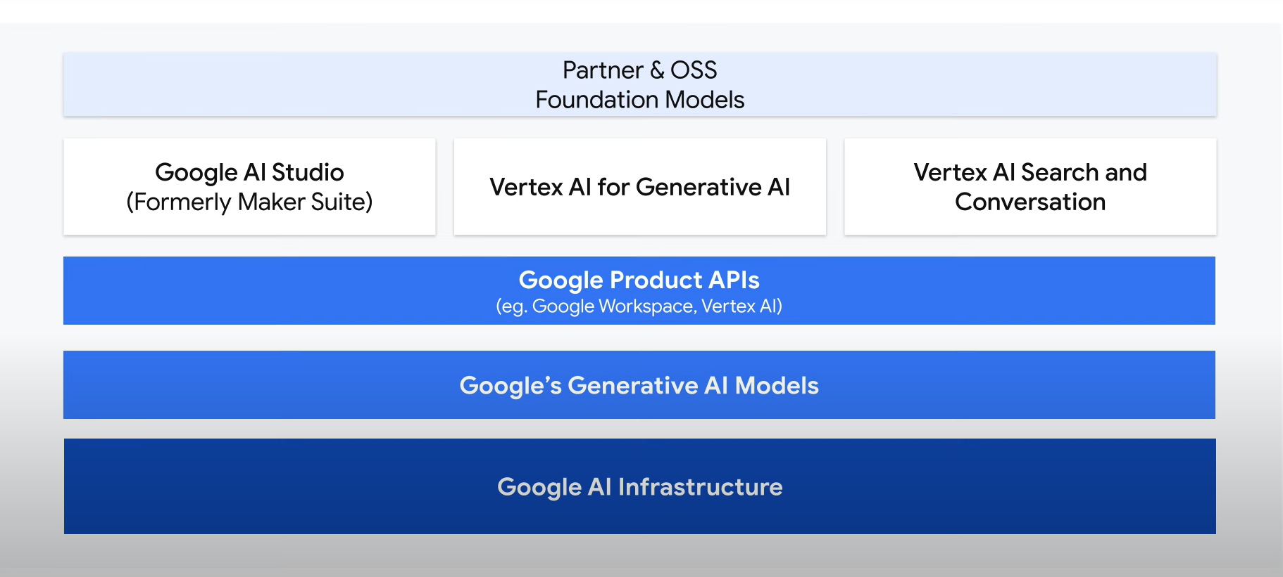



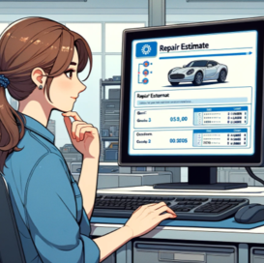
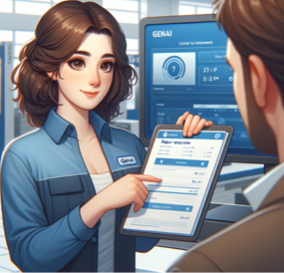





Various Users Could Benefit from Streamlining the Repair Estimation Process
Target Users
Bureaucratic Hurdles:
3 different repair estimates are typically claimed by Insurance.
GAIN CREATORS FOR THREE POTENTIAL USER GROUPS
Efficiency Boost: Speedier, more accurate estimate generation.
Reputation Enhancement: Trustworthiness through precise estimates.
Workflow Optimization: Streamlined processes reduce operational bottlenecks.
Claim Processing Speed: Faster turnaround on estimates and approvals.
Assessment Precision: Enhanced accuracy in evaluating claims.
Operational Efficiency: Reduced manual effort in estimate reviews.
Confidence in Repairs: Increased trust through transparent repair processes.
Cost Clarity: Clear insights into repair costs and timelines.
Stress Reduction: Less anxiety with quicker, understandable estimation communications.
Car Repair Professionals
Insurance Reviewers
Vehicle
Owners
Insurance Communication
Focus of our PoC
Response Delays: Slow insurance feedback.
Dispute Potential: Risk of estimate contention.
Multiple Estimates: Extended approval times.
USER JOURNEY FOR EMILY FROM OUR SELECTED USER GROUP
KEY FEATURES
Automated Repair Assessment
Comprehensive Damage Analysis
Precise Cost Estimation
Fast Processing
Seamless Insurance Integration
Add claire logo
Add mini icons per feature
Highlight as this is n important box
1
Emily, the car repair professional receives yet another repair estimate request.
2
Emily follows the estimation guide led by GenAI chatbot Claire and uses photos to assess visible damages.
3
Emily controls and potentially adjusts the damage and cost estimations.
4
Emily shares the results with the customer and the insurance company.
Notes:
https://gitnux.org/u-s-auto-repair-industry-statistics/
When You Should Avoid Going Through Your Insurance for Car Repair | Valley Collision UT
When You Should Avoid Going Through Your Insurance for Car Repair | Valley Collision UT
https://www.ddlawtampa.com/resources/car-accident-statistics-you-need-to-know-in-2021/#:~:text=Total%20number%20of%20car%20accidents%20per%20year%20in%20the%20U.S.&text=This%20is%20up%20from%20238.6,losing%20their%20lives%20each%20year.

Slide 4







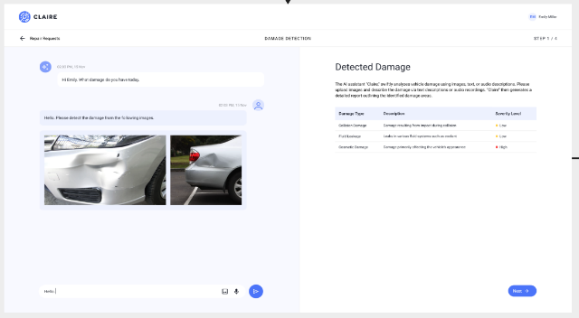



We Introduce CLAIRE, Chat-based Tool for Car Inspection
Solution and technical components
Vehicle information request
CHAT-BASED GUIDANCE THROUGH THE PROCESS
Provides vehicle information
Prompt augmentation
with system prompt
Chatbot Model
Gemini-1-pro
Role: Interacts with the user and masterminds the assessment, guides the user throughout the entire inspection routine
API request formation
GUI output
Vehicle information
API response parsing
Damage information request
User output
Vehicle information collection is the very first step after greeting
DAMAGE COLLECTION FROM IMAGEs AND VIA CHAT
Image Model
Gemini-1-pro-Vision
Role: takes care of specific image-based assessment tasks and provides damage description to the chatbot model
Uploads image
Prompt augmentation
with image prompt
API request formation
Car Repair
Professional
GUI output
Damage information
API response parsing
Damage assessment completed
User output
Damage estimation is multistep conversation where both text and images are considered
COST ASSESMENT USING DIVERSE DATA SOURCES
Damage information
Triggers cost estimation
by pressing the button
Data Search Model
Vertex-Search
Role: queries the damages in dedicated data stores to produce cost assessment
Prompt augmentation
API request formation
GUI output
Cost estimation
API response parsing
Cost estimation uses the vehicle information, damage estimation and external data sources
Notes:
https://gitnux.org/u-s-auto-repair-industry-statistics/
When You Should Avoid Going Through Your Insurance for Car Repair | Valley Collision UT
When You Should Avoid Going Through Your Insurance for Car Repair | Valley Collision UT
https://www.ddlawtampa.com/resources/car-accident-statistics-you-need-to-know-in-2021/#:~:text=Total%20number%20of%20car%20accidents%20per%20year%20in%20the%20U.S.&text=This%20is%20up%20from%20238.6,losing%20their%20lives%20each%20year.

Slide 5

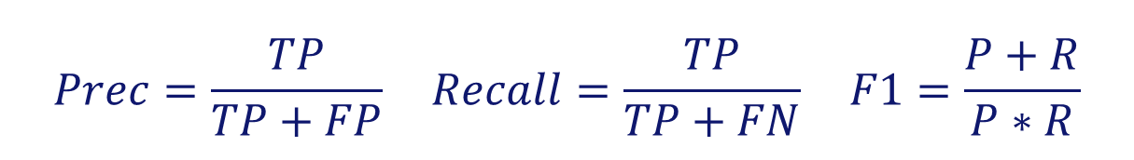
We Established a Framework for Measuring the Model on Technical Reliability and Delivery Effectiveness
METRICS
PERFORMANCE METRICS ON THE AI SYSTEM
BUSINESS RELEVANCE
We have two main components in our architecture
which majorly influence the performance.
Cost Structure
Revenue Model
Development and Maintenance: Creation and upkeep of GenAI system.
Data Acquisition: Obtaining labor and car part cost databases.
Integration: Connecting GenAI with existing systems.
Support and Training: Personnel training and ongoing support.
Subscription Fees
Fixed Costs
Service centers pay a monthly fee for access to GenAI
Charges per estimate generated by GenAI
Damage Assessment
F1
Score
$$Prec=\frac{TP}{TP+FP} Recall=\frac{TP}{TP+FN} F1=\frac{P+R}{P∗R}$$
Usage-Based Pricing
Balances the precision and recall in detecting the damaged vehicle parts.
Precision: Ensure the model detects vehicle parts that are truly damaged
Recall: Assess the completeness of detections, evaluating the risk of detecting too many or few damaged vehicle parts
Variable Costs
Cost Estimation
Cost
Error Rate
$$Cost Error Rate= \frac{ { Cost}_{Estimated}−{ Cost}_{Actual}}{{ Cost}_{Actual}}$$
Measure of Effectiveness and Value
Measures deviation between estimated and actual repair costs.
Total Costs: Average absolute difference between estimated and actual total repair costs, assessing estimation accuracy overall.
Costs per Part: Average absolute difference between estimated and actual costs for individual vehicle parts, offering insights into part-specific estimation accuracy.
Improved Repair Center Throughput
Assess increase in repairs per unit time from streamlined estimation.
Decrease Repair Estimation Time
Evaluate time saved by using GenAI compared to manual methods.
Improvement in Repair Estimation Accuracy
Assess precision and reliability of damage and cost estimates generated.
Increased Customer Satisfaction
Evaluate impact of faster, accurate estimates and smoother claims processing.
Notes:
https://gitnux.org/u-s-auto-repair-industry-statistics/
When You Should Avoid Going Through Your Insurance for Car Repair | Valley Collision UT
When You Should Avoid Going Through Your Insurance for Car Repair | Valley Collision UT
https://www.ddlawtampa.com/resources/car-accident-statistics-you-need-to-know-in-2021/#:~:text=Total%20number%20of%20car%20accidents%20per%20year%20in%20the%20U.S.&text=This%20is%20up%20from%20238.6,losing%20their%20lives%20each%20year.

Slide 6






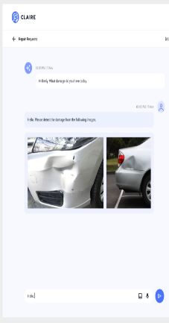
We Plan to Develop, Deploy and Scale Claire as a Web-Based App within 7 Months in a Team of 8 Professionals
Still needs input
Execution Plan: Describe how you intend to deploy and distribute your AI solution, for example through a web app, mobile app, direct API, etc. Provide a timeline for achieving key milestones and reaching the target users or customers.
Execution plan
1. Planning & Design
2. Development of Web-Based Application
3.1 Deployment & Scaling
3.2 Marketing and Promotion
1 Month
5 Months
2 Months
Requirements Analysis Conducting Interviews and Market Analysis
App Architecture Designing for scalability and reliability
UX&UI Design Concept User-friendly interface designs
Frontend Development UI & UX Implementation
Backend Development - Data Infrastructure Design - Prompt Engineering - Voice Integration
Dockerization Easy deployment and management
Deployment on GCP Deploying on Google Cloud Platform
Scalability Testing and Improvements Handle increased loads and traffic efficiently
Parrallel Activity to Deployment & Scaling
Reaching out to Car Workshops Establishing partnerships with automotive repair shops
Creating a Promotion Content Marketing materials to promote Claire
Requirement specified
Software architecture ready
UX&UI concept prepared
Functional prototype ready
App launched
App tested
Team Roles (8 people)
Delivery Format
Voice integration using Chirp
Automated inventory check
Integration of supplies’ systems for price and availability check
Insurance approval integration
End-to-End Solution for the Car Repair Process
Project manager (1)
GenAI expert (1)
UX&UI designer (1)
Cloud engineer (1)
Software developers (3)
Data engineer (1)
Desktop Web App for professional usage
Mobile App
for quick input
Notes:
https://gitnux.org/u-s-auto-repair-industry-statistics/
When You Should Avoid Going Through Your Insurance for Car Repair | Valley Collision UT
When You Should Avoid Going Through Your Insurance for Car Repair | Valley Collision UT
https://www.ddlawtampa.com/resources/car-accident-statistics-you-need-to-know-in-2021/#:~:text=Total%20number%20of%20car%20accidents%20per%20year%20in%20the%20U.S.&text=This%20is%20up%20from%20238.6,losing%20their%20lives%20each%20year.

Slide 7








Thank you.
Rami Hachicha
Senior Consultant, Invent
Data Scientist, Developer
Valentin Khaydarov
Senior Consultant, Invent
Data Scientist, Developer
Gargi Sarkar
Consultant, Capgemini
Developer
Embrace the future of car inspection with GenAI technologies by using
Vincent Kammerer
Consultant, Invent
Data Analyst
Kim Anh Lilian Lê
Consultant, Invent
Data Analyst
Anita Tuma
Experience Designer, frog
Designer

